Slide 1

Sentiment Analysis for Movie Reviews
An intelligent NLP-powered system that automatically classifies movie reviews as positive, negative, or neutral — delivering actionable audience insights through machine learning and natural language processing.
ACADEMIC PROJECT
NLP · MACHINE LEARNING · SENTIMENT ANALYSIS

Slide 2
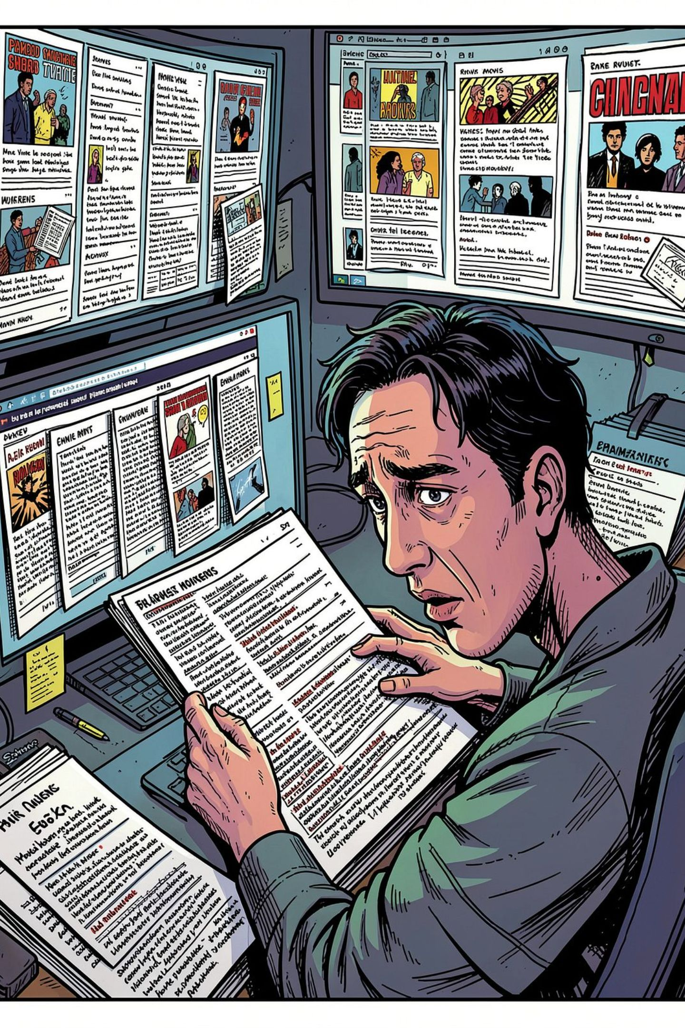
The Problem: Understanding Audience Sentiment at Scale
Movie platforms receive thousands of reviews daily. Manually interpreting this volume is impractical — and critical audience signals go undetected.
Volume Overload
Subjectivity Gap
Millions of reviews posted daily across platforms — impossible to analyze manually.
Human bias and inconsistency make manual sentiment labeling unreliable at scale.
Delayed Insights
Without automation, audience trends surface too late to inform decisions.

Slide 3
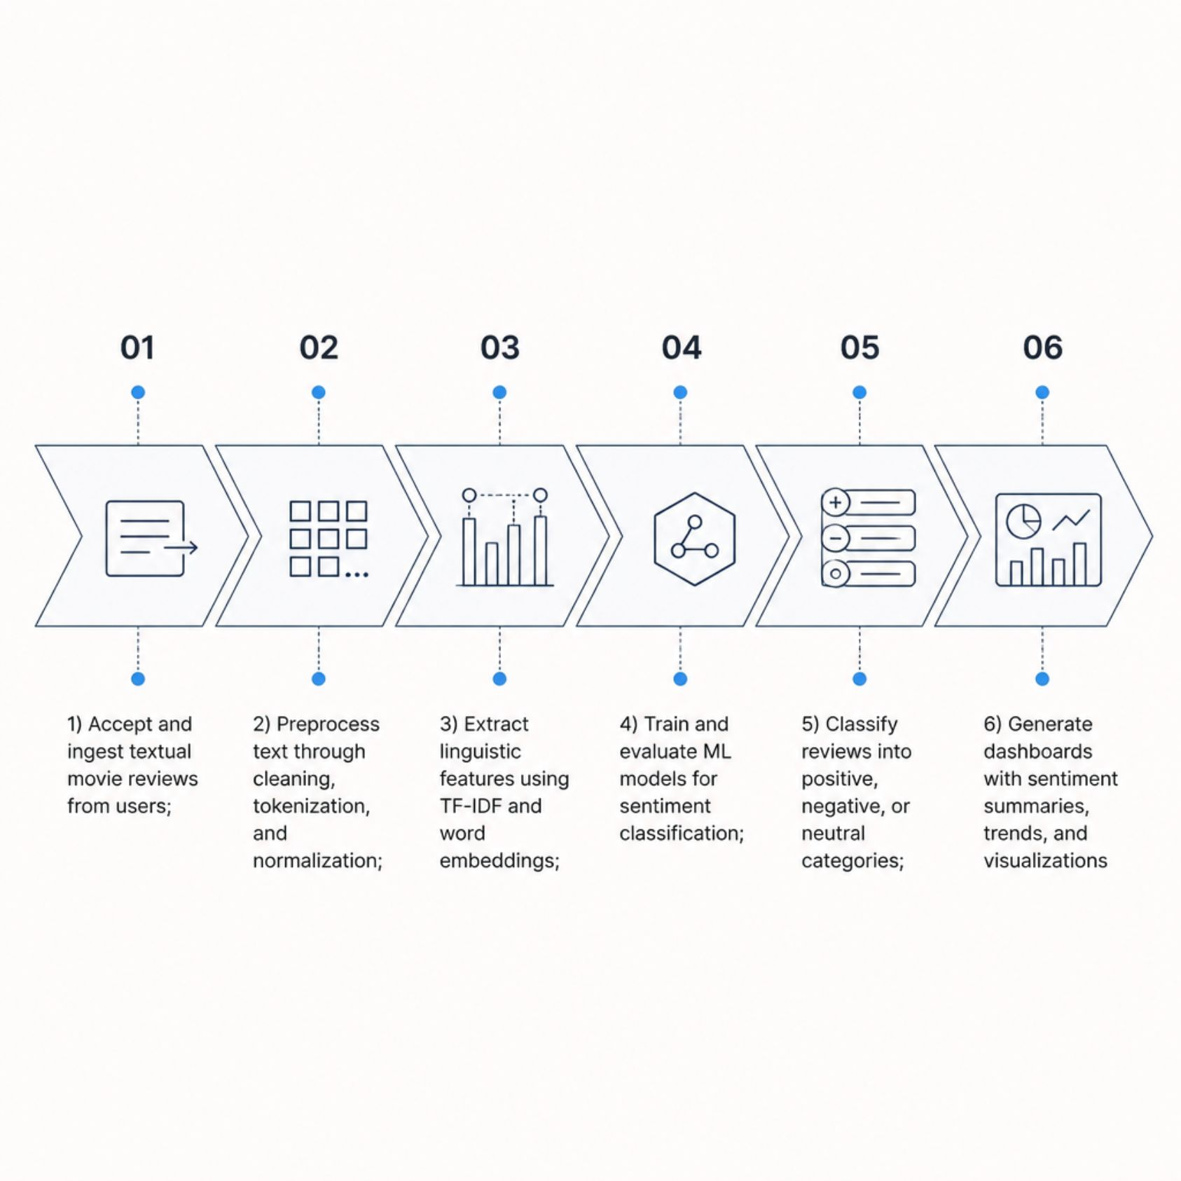
Project Objectives
What We Set Out to Build
The system bridges raw user-generated text and structured audience intelligence — automating opinion mining from ingestion to insight.
Automate sentiment classification with high accuracy
Deliver real-time predictions through a user-friendly interface
Generate trend reports and sentiment distribution visualizations
Support data-driven decisions for content and marketing teams

Slide 4
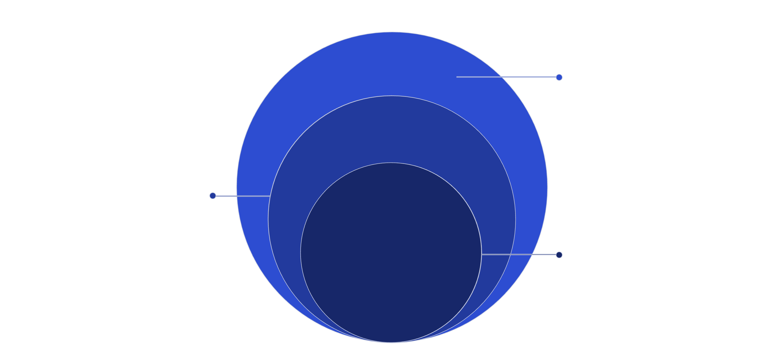
System Architecture
Input & Output
User review input; sentiment label and dashboard
Processing Layer
Preprocessing, tokenization, feature extraction
Core ML Engine
Logistic Regression, LSTM, BERT models
The pipeline flows seamlessly from raw text input through NLP preprocessing and ML classification to structured sentiment output — all orchestrated within a secure, scalable backend.

Slide 5
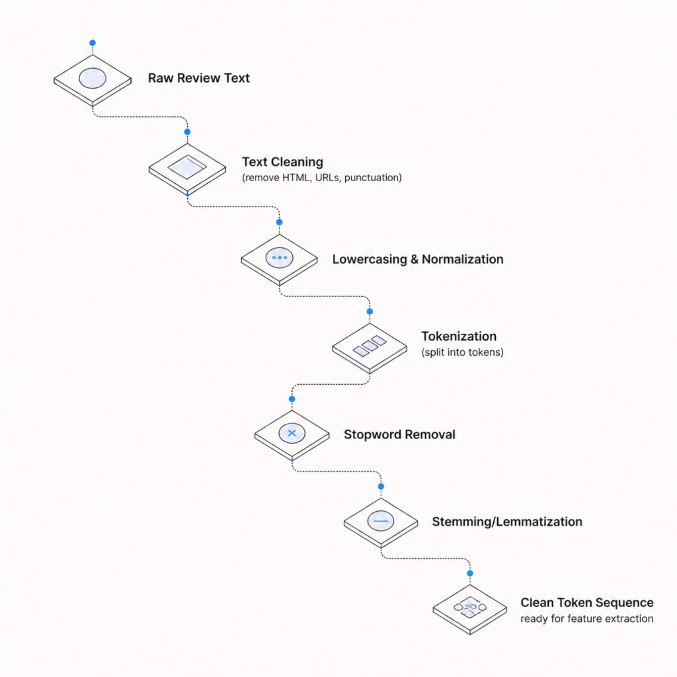
NLP Pipeline & Text Preprocessing
From Raw Text to Clean Tokens
Every review undergoes a standardized preprocessing sequence to reduce noise and normalize language before feature extraction.
01
02
Text Cleaning
Lowercasing & Normalization
Remove HTML tags, special characters, URLs
Standardize casing and expand contractions
03
04
Tokenization
Stopword Removal & Stemming
Split text into words or subword units
Filter noise words; reduce to root forms

Slide 6

Feature Extraction & Sentiment Classification
Representing Text for Machine Learning
Preprocessed tokens are converted into numerical representations that ML models can learn from.
Bag-of-Words (BoW)
TF-IDF Vectorization
Word Embeddings (Word2Vec / GloVe)
Transformer Embeddings (BERT)
Counts word occurrences; simple and interpretable.
Weights words by importance — penalizes common terms.
Captures semantic meaning in dense vector space.
Contextual representations for state-of-the-art accuracy.

Slide 7
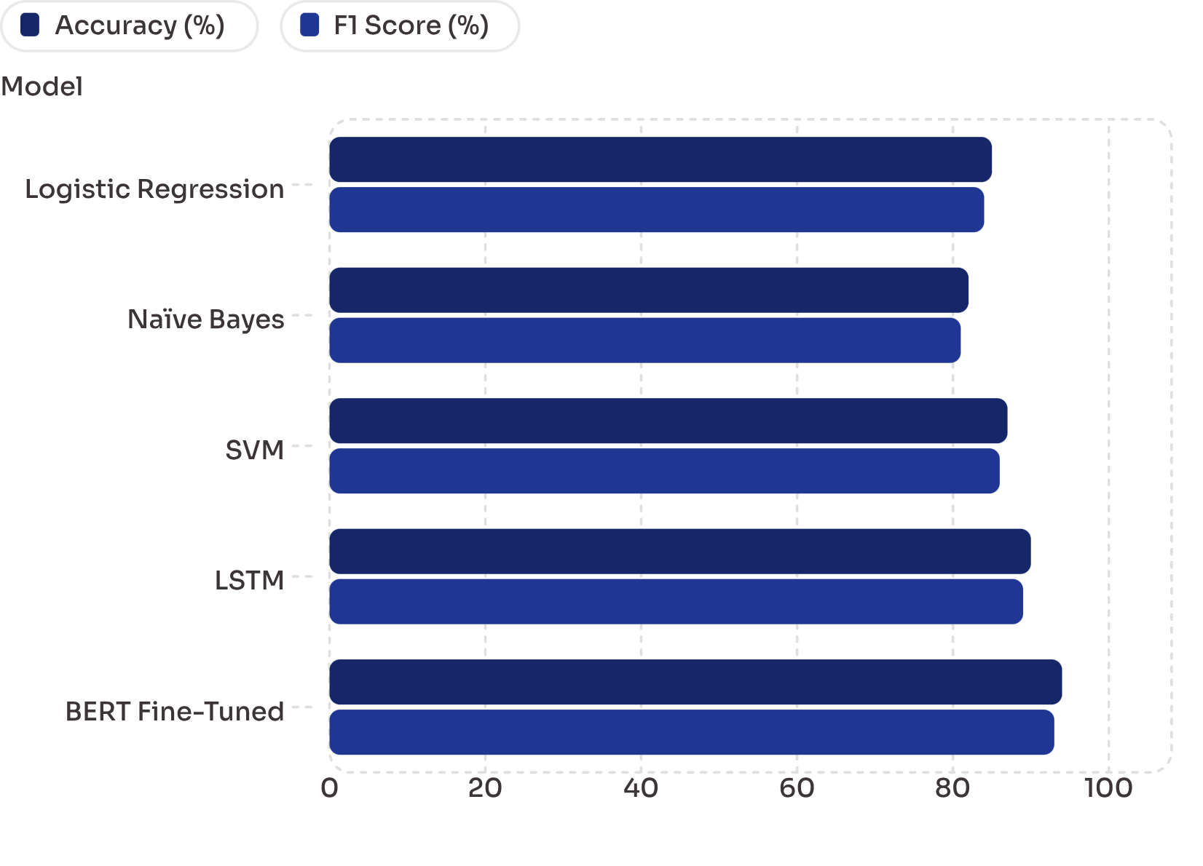

Model Training & Evaluation
Benchmarking Classification Performance
Models are trained on labeled datasets (e.g., IMDb, Rotten Tomatoes) and evaluated on accuracy, precision, recall, and F1 score.
Confusion Matrix analysis reveals per-class performance — identifying whether the model confuses neutral reviews with positive or negative ones.
BERT consistently outperforms traditional models by leveraging contextual understanding of language.

Slide 8

Analytical Dashboard & Key Features
Sentiment Distribution
Visual breakdown of positive, negative, and neutral reviews per movie.
Trend Analysis
Track sentiment shifts over time to detect audience reaction patterns.
Model Performance Monitor
Real-time accuracy, F1, and confusion matrix metrics for live models.
Secure & Scalable
Role-based access, encrypted data storage, and cloud-ready architecture.

Slide 9
Applications, Advantages & Limitations
Real-World Use Cases
Advantages
Streaming Platforms
High classification accuracy with transformer models
Fully automated — no manual labeling required post-training
Scalable to millions of reviews per day
Automate review moderation and highlight audience favorites.
Marketing Teams
Limitations
Gauge campaign impact and audience reception in real time.
Sarcasm and irony remain challenging to detect
Domain-specific slang may reduce accuracy
Neutral class often underrepresented in training data
Social Media Monitoring
Track brand sentiment across Twitter, Reddit, and forums.

Slide 10
Future Enhancements & Conclusion
Roadmap Ahead
Conclusion
Phase 1 — Multilingual Support
1
This system demonstrates how NLP and machine learning can transform unstructured movie reviews into structured, actionable audience intelligence.
Extend NLP pipeline to Spanish, Hindi, and Mandarin reviews.
2
Phase 2 — Aspect-Level Sentiment
By automating sentiment classification, the platform empowers stakeholders to make faster, data-driven decisions — turning raw opinions into measurable insight.
Detect sentiment toward specific movie elements: acting, plot, cinematography.
Phase 3 — Real-Time API
3
Deploy RESTful API for third-party integration with streaming and review platforms.
Accurate
Scalable
Insightful
Up to 94% with BERT
Cloud-ready architecture
Rich dashboards & trends

